Slide 1
S3 Encryption
In Transit:
SSL / TLS
At rest:
Server Side Encryption:
S3 Managed Keys - SSE-S3 (AES 256)
AWS Key Management Service, Managed Keys, SSE-KMS
Server Side Encryption with Customer Provided Keys - SSE-C
Client Side Encryption

Slide 2
Enforcing Encryption on
S3 Buckets
Every time a file is uploaded to S3, a PUT request is initiated
This is what a PUT request looks like:
PUT /myfile HTTP/1.1
Host: myBucket.s3.amazonaws.com
Date: Thu, 8 Aug 2019 12:54:27 GMT
Authorisation: authorisation string
Content-Type: text/plain
Content-Length: 27364
x-amz-meta-author: Anmol
Expect: 100-continue
[27364 bytes of object data]

Slide 3
Enforcing Encryption on
S3 Buckets
If the file is to be encrypted at upload time, the x-amz-server-side-
encryption parameter will be included in the request header
Two options are currently available:
x-amz-server-side-encryption: AES256 (SSE-S3 - S3 managed keys)
x-amz-server-side-encryption: ams:kms (SSE-KMS - KMS managed keys)
When this parameter is included in the header of the PUT request, it tells
S3 to encrypt the object at the time of upload, using the specified
encryption method
You can enforce the use of Server Side Encryption by using a Bucket
Policy which denies any S3 PUT request which doesn’t include the
x-amz-server-side-encryption parameter in the request header

Slide 4
Enforcing Encryption on
S3 Buckets
The following request tells S3 to encrypt the file using SSE-S3 (AES 256)
at the time of upload:
PUT /myfile HTTP/1.1
Host: myBucket.s3.amazonaws.com
Date: Thu, 8 Aug 2019 12:54:27 GMT
Authorisation: authorisation string
Content-Type: text/plain
Content-Length: 27364
x-amz-meta-author: Anmol
Expect: 100-continue
x-amz-server-side-encryption: AES256
[27364 bytes of object data]

Slide 5
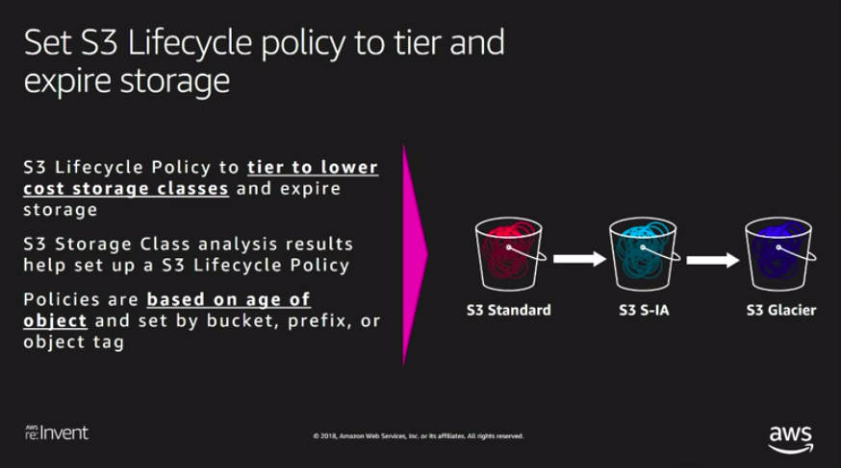

Slide 6
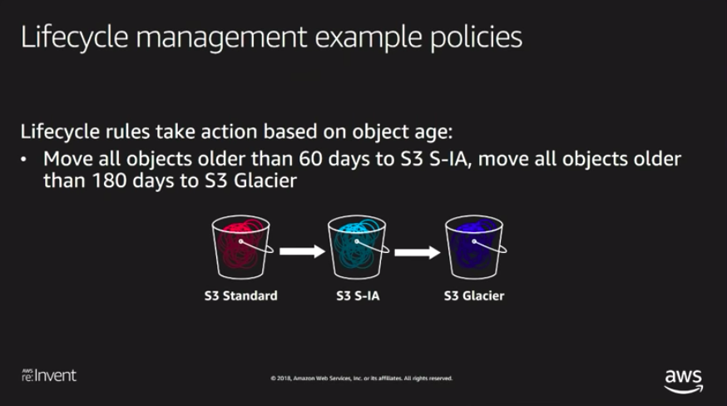

Slide 7
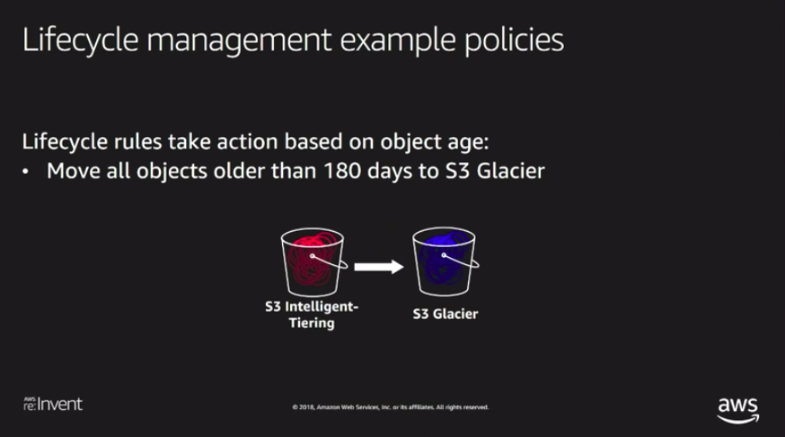

Slide 8
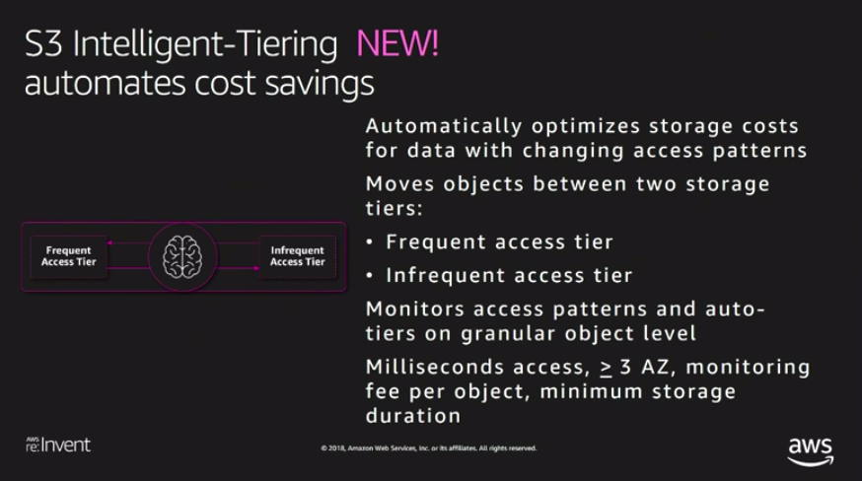

Slide 9
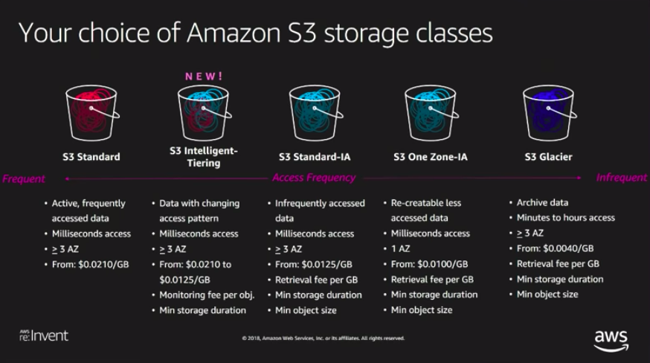

Slide 10
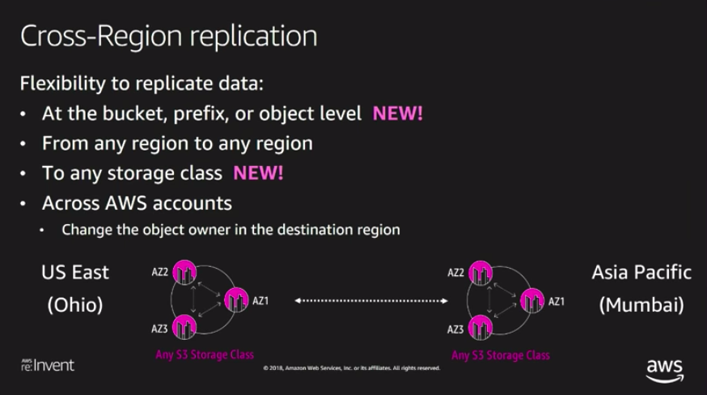

Slide 11
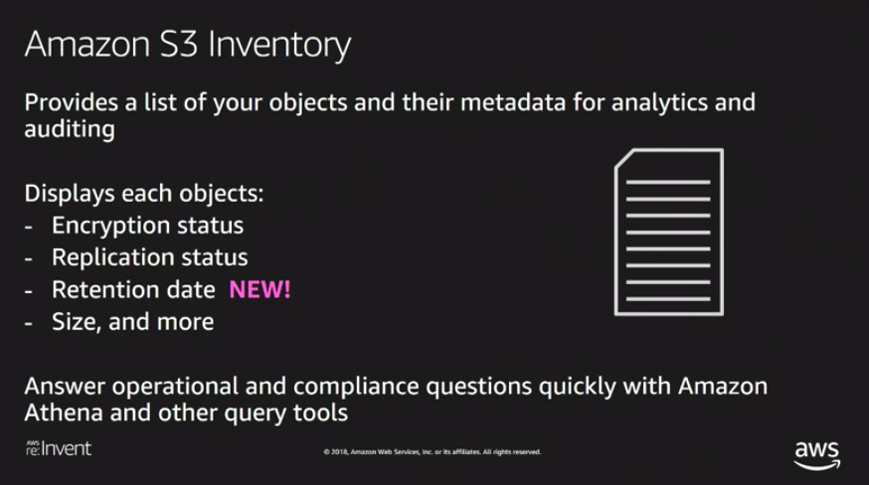

Slide 12
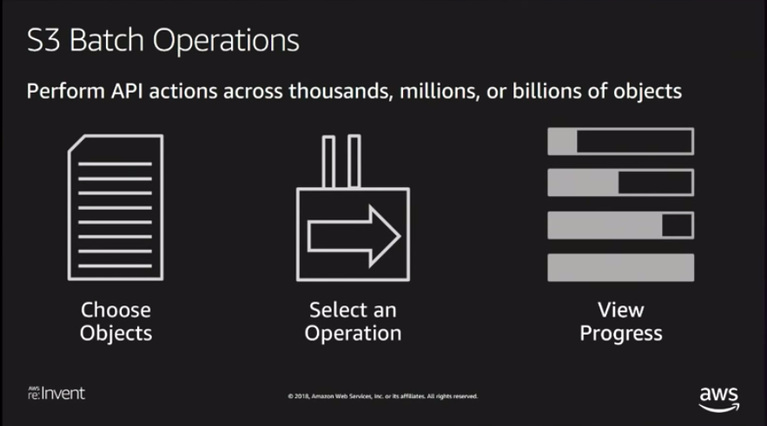

Slide 13
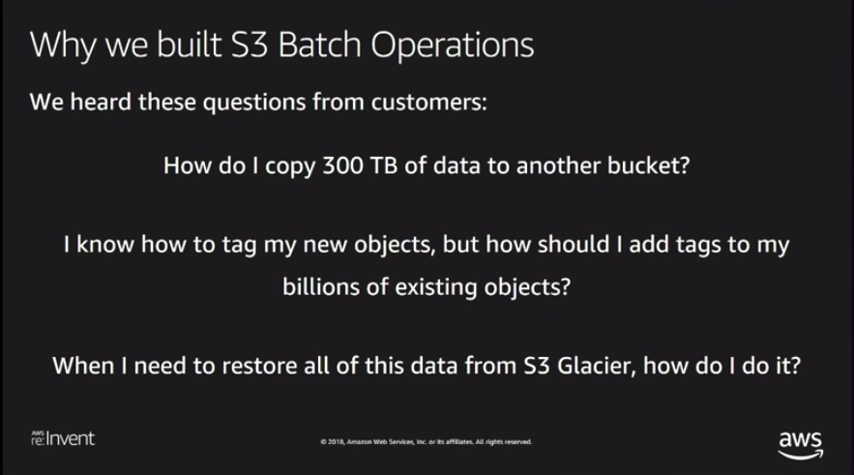

Slide 14
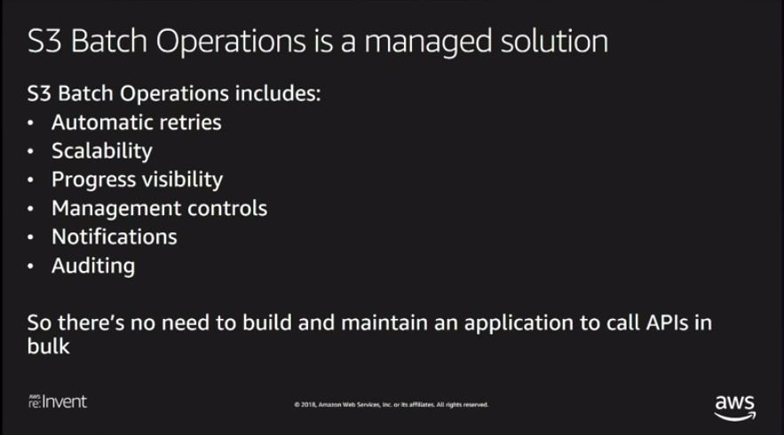

Slide 15
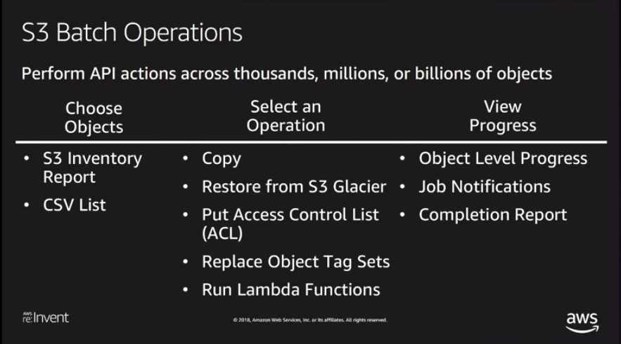

Slide 16
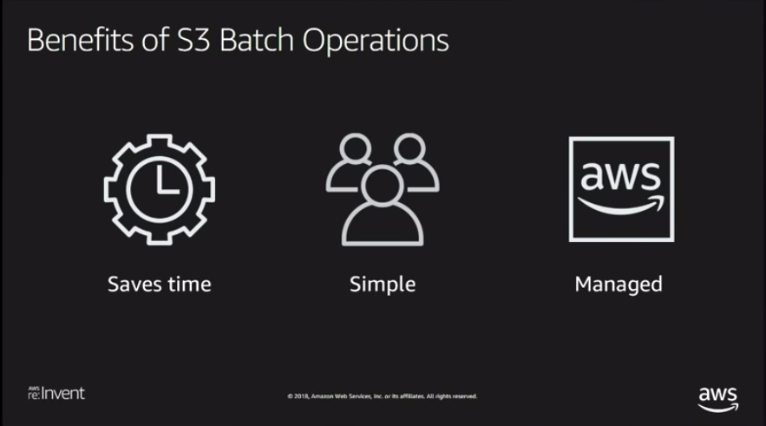

Slide 17
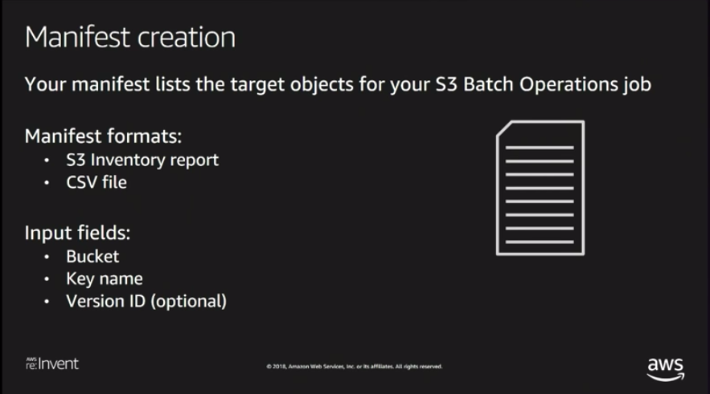

Slide 18
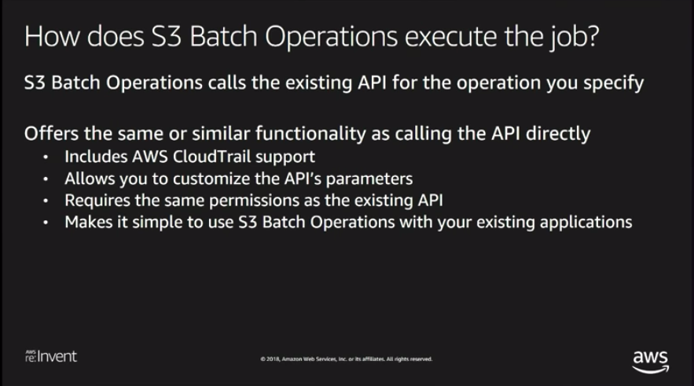

Slide 19
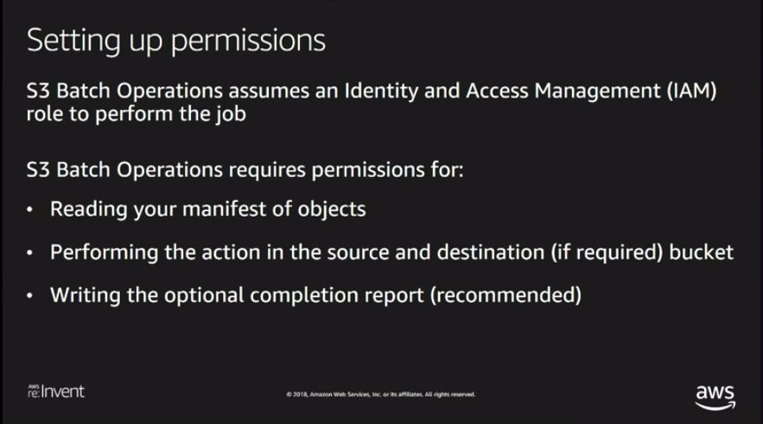

Slide 20
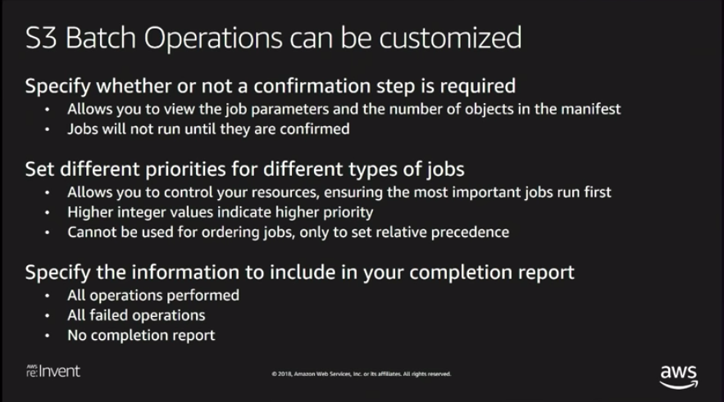

Slide 21
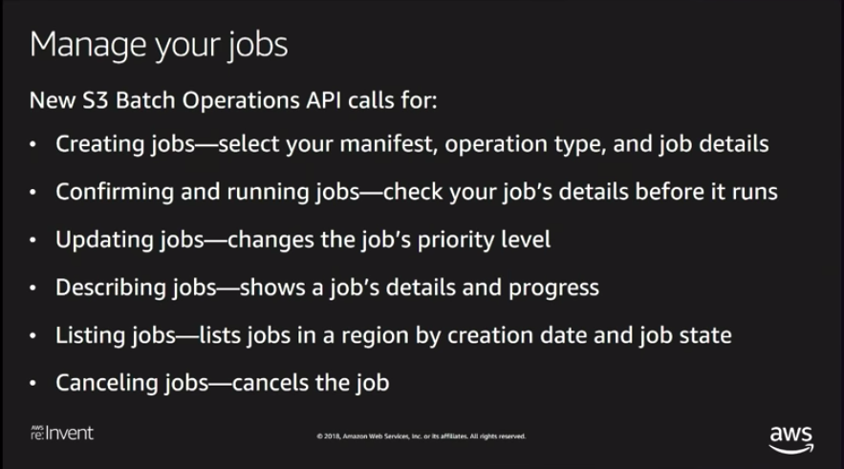

Slide 22
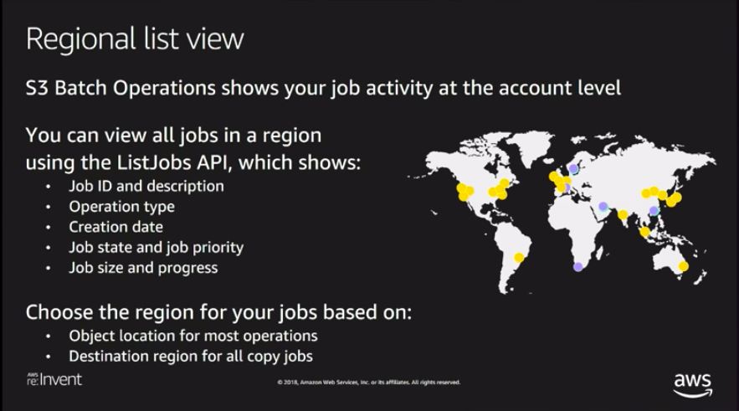

Slide 23
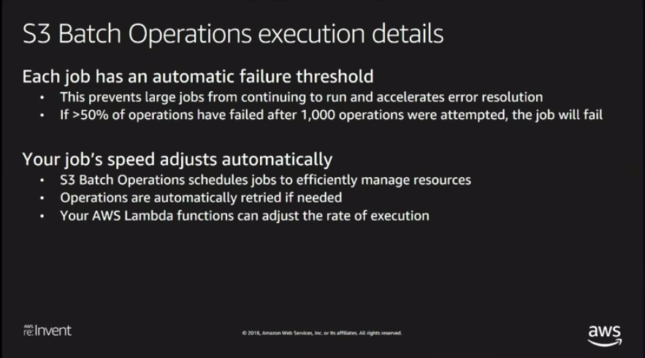

Slide 24
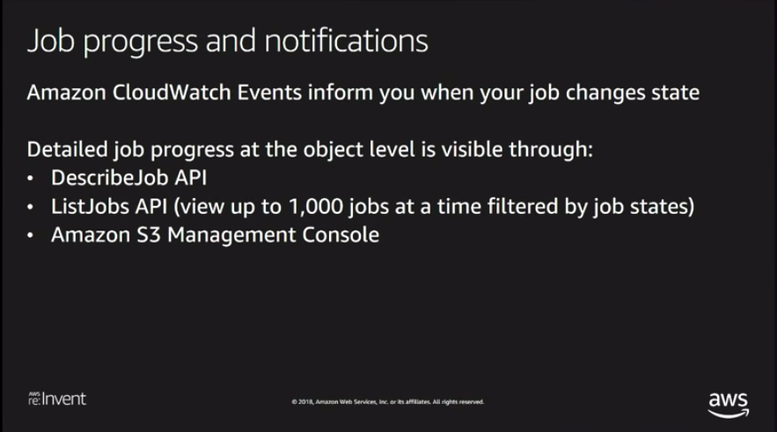

Slide 25
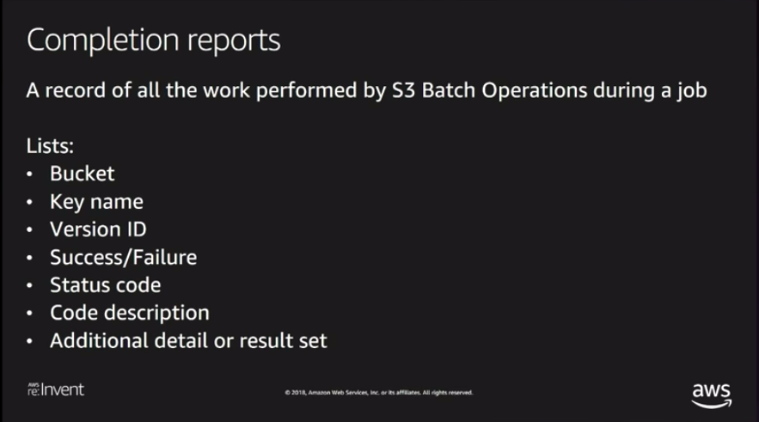

Slide 26
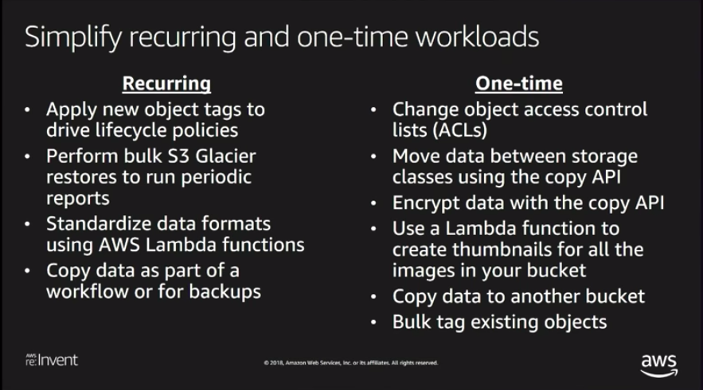

Slide 27
CDN
A Content-Delivery Network (CDN) is a system of distributed servers (network) that deliver webpages and other web content to a user based on the geographic locations of the user, the origin of the webpage, and a content delivery server

Slide 28


S3

Slide 29

S3

Slide 30
Amazon CloudFront
Fast, highly secure and programmable content delivery network (CDN)

Slide 31
CloudFront - Key Terminology
Edge Location - This is the location where content is cached and can also
be written. Separate to an AWS Region / AZ.
Origin - This is the origin of all the files that the CDN will distribute.
Origins can be an S3 Bucket, an EC2 Instance, an Elastic Load Balancer, or
Route53.
Distribution - This is the name given to the CDN, which consists of a
collection of Edge Locations.
Web Distribution - Typically used for websites (HTTP/HTTPS)
RTMP Distribution - Used for media streaming (Real Time Messaging
Protocol)

Slide 32

Amazon CloudFront is a fast content delivery network (CDN) service that securely delivers data, videos, applications, and APIs to customers globally with low latency, high transfer speeds, all within a developer-friendly environment. CloudFront is integrated with AWS – both physical locations that are directly connected to the AWS global infrastructure, as well as other AWS services. CloudFront works seamlessly with services including AWS Shield for DDoS mitigation, Amazon S3, Elastic Load Balancing or Amazon EC2 as origins for your applications, and Lambda@Edge to run custom code closer to customers’ users and to customise the user experience. Lastly, if you use AWS origins such as Amazon S3, Amazon EC2 or Elastic Load Balancing, you don’t pay for any data transferred between these services and CloudFront.

Slide 33
CloudFront & S3 Transfer Acceleration
Amazon S3 Transfer Acceleration enables fast, easy, and secure transfers
of files over long distances between your end users and an S3 bucket.
Transfer Acceleration takes advantage of Amazon CloudFront’s globally
distributed edge locations. As the data arrives at an edge location, data is
routed to Amazon S3 over an optimised network path.

Slide 34
S3

Slide 35
Amazon CloudFront
Fast
Highly Secure
And programmable Content Delivery Network service

Slide 36




With CloudFront you can deliver your content and applications to millions of users at scale
You can deliver both static and dynamic content

Slide 37
CloudFront has a worldwide network of data centres called edge locations and is integrated with AWS at physical locations directly connected to the expanding AWS global infrastructure

Slide 38

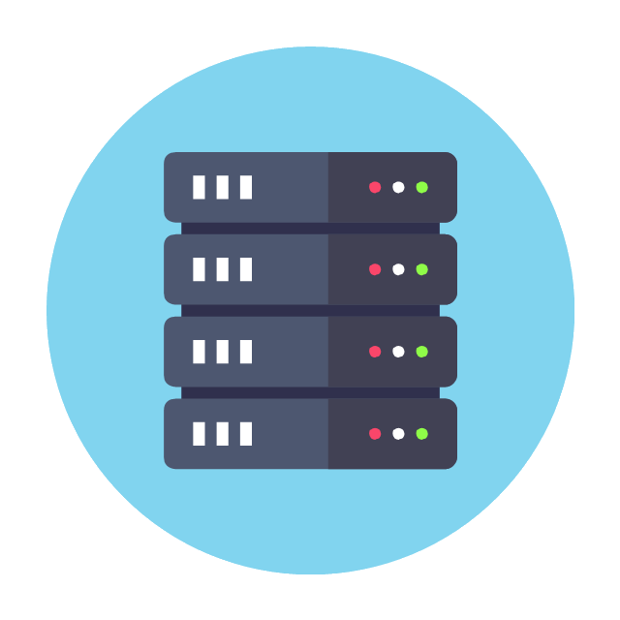
You can use either an AWS origin or your own custom origin server

Slide 39

CloudFront helps you deliver content securely to your customers
You can encrypt your communications with a free custom TLS certificate from Amazon Certificate Manager or you can import your own certificate

Slide 40

You also get DDoS protection with AWS Shield Standard by default
You receive comprehensive availability protection against all known layer 3 & 4 network attacks
AWS Shield provides always-on detection and automatic inline mitigations that minimise application downtime and latency

Slide 41

CloudFront also integrates seamlessly with AWS WAF for application layer protection

Slide 42




CloudFront’s infrastructure and processes are all compliant with a wide range of standards to ensure delivery of the most sensitive data

Slide 43

With the Lambda@Edge feature you can run complex application logic closer to your customers
CloudFront and Lambda@Edge automatically scale and replicate your application logic globally without you having to scale your own origin infrastructure

Slide 44
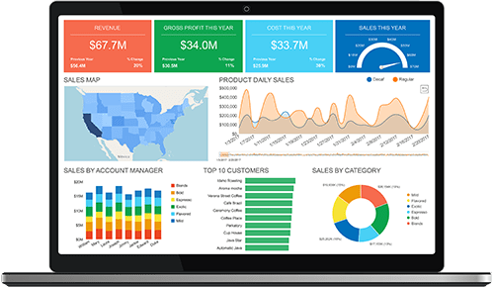
You can go serverless and offer dynamic and highly personalised web applications with Lambda@Edge

Slide 45



Using CloudFront makes financial sense - data transfer out from other AWS origins to CloudFront is free

Slide 46

CloudFront accelerates and protects many types of traffic, all under the same pricing structure

Slide 47

And with Amazon CloudFront pay-as-you-go pricing model, you pay for only what you use

Slide 48
CloudFront Benefits
Fast and Global
Security at the Edge
Highly Programmable
Deep Integration with AWS

Slide 49

Case Studies
Hulu uses Amazon CloudFront for its VOD delivery

Slide 50

Case Studies
Amazon Prime Video uses Amazon CloudFront to deliver solid streaming experience
to more than 18 million football fans

Slide 51

Case Studies
King uses CloudFront to deliver game content to a global user base

Slide 52
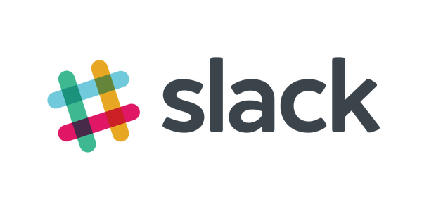
Case Studies
Slack uses Amazon CloudFront for secure API acceleration

Slide 53

Case Studies
Rovio uses the CDN for reduced latencies from around the globe for API calls

Slide 54

Case Studies
Discovery uses Amazon CloudFront for static, dynamic and API delivery

Slide 55

Case Studies
Canon uses the CDN to enable better user experience

Slide 56

Case Studies
Dow Jones uses Amazon’s CDN to manage spikes in traffic and security

Slide 57

Case Studies
Amazon CloudFront delivers a scalable solution to serve up the APIs

Slide 58

Case Studies
Bandai Namco uses Amazon CloudFront as its Content Delivery Network (CDN)

Slide 59

Case Studies
PBS uses Amazon CloudFront for its video streaming

Slide 60

Case Studies
The startup uses Amazon CloudFront for fast content delivery and for fast software
builds deployments

Slide 61

Case Studies
Supercell uses Amazon CloudFront to deliver dynamic web content around the world,
using edge locations for improved latency

Slide 62

Case Studies
“We selected Amazon CloudFront for the superior performances in terms of
video start time, throughput, and the lower rebuffing rate.”
- Yann Verry, System and Network Manager at Groupe M6

Slide 63

Case Studies
Seven Networks used Amazon’s Content Delivery Network (CDN) for the live video
streaming of the Australian Open to millions

Slide 64

Case Studies
‘Like the famous song says, CloudFront is “Harder, Better, Faster, Stronger”!’
- Marco Vigano, Digital CTO at Condé Nast Italia

Slide 65
CloudFront Use Cases
Static Asset Caching
Live and On-Demand Video Streaming
Security
Customisable Content Delivery with Lambda@Edge
Dynamic Content and API Acceleration
Software Distribution

Slide 66
S3 Performance Optimisation
S3 is designed to support very high request rates. However, if your S3
buckets are routinely receiving >100 PUT / LIST / DELETE or >300 GET
requests per second, then there are some best practice guidelines that
will help optimise S3 performance.
The guidance is based on the type of workload you are running:
GET-Intensive workloads - Use CloudFront content delivery service to
get best performance. CloudFront will cache your most frequently
accessed objects and will reduce latency for your GET requests.

Slide 67
S3 Performance Optimisation
Mixed Request Type Workloads (a mix of GET, PUT, DELETE, GET Bucket)
The key names you use for your objects can impact performance for
intensive workloads
S3 uses the key name to determine which partition an object will be
stored in
The use of sequential key names e.g. names prefixed with a time stamp
or alphabetical sequence increases the likelihood of having multiple
objects stored on the same partition
For heavy workloads this can cause I/O issues and contention
By using a random prefix to key names, you can force S3 to distribute
your keys across multiple partitions, distributing the I/O workload

Slide 68
S3 Key Name Example
The following sequential Key Names are not optimal:
mybucket/2019-08-21-01-00-00/cust1234234/photo1.jpg
mybucket/2019-08-21-01-00-00/cust3857422/photo2.jpg
mybucket/2019-08-21-01-00-00/cust1248473/photo3.jpg
For optimal performance, introduce some randomness into the key name,
e.g. prefix the key name with a 4-character hexadecimal hash:
mybucket/7eh4-2019-08-21-01-00-00/cust1234234/photo1.jpg
mybucket/h35d-2019-08-21-01-00-00/cust3857422/photo2.jpg
mybucket/o3n6-2019-08-21-01-00-00/cust1248473/photo3.jpg

